Slide 1
Activity Classification from Sensor Data
DRAFT

Slide 2

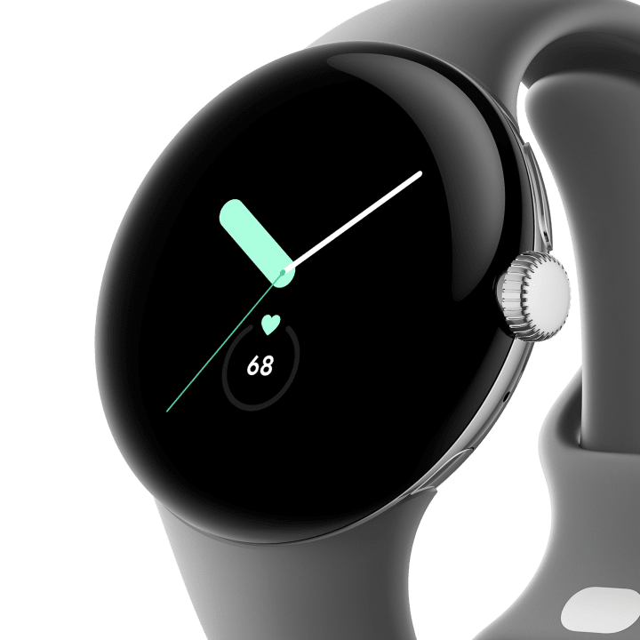
Problem Statement
Company
Based on World Health Organization, the world’s population with over 60 yrs old will double reaching 2.1B by 2050. Domestically, in US, older adults are projected to outnumber children by 2034. Beyond the complication with an aging population, over 50% of the population has at least 1 chronic condition such as diabetes, stroke, obesity. This will inherently drive the cost of health care higher over next decade.
Google’s parent company, Alphabet, is a multinational technology company focusing on internet search, AI, advertising, cloud computing and consumer devices.
Objective
Google has a consumer electronic brand, Pixel, that develop smartphone and smartwatch that runs on Android. Around 70% of smartphones in the world runs on Android mobile platform, competing with Apple iOS.
Over 95% of US population own a smartphone and over 25% of adults now owns a wearable like a smart watch. These communication devices are equipped with sensors such as accelerometer, gyroscope and magnetic sensor to determine location and movement.
The objective is to use sensor data to build a classification model to predict a person’s activity such as standing, sitting, sleeping, to movement such as walking, running. These model can be used as monitoring application for healthcare and wellness purposes to better understand a person’s lifestyle.
In the wearable smartwatch market, Apple and Samsung dominate the market. Google has acquired Fitbit back in 2019 to further its development of wearable.
Google’s hardware products account
for about 7% of its revenue in recent financial statement.

Slide 3
Design Process
Empathize | Define | Ideate | Prototype | Test
For monitoring application, the wearable can be used to track an user daily activity to better understand their movement throughout the day. | What data should this activity classifier API serve? | Build an activity classification model | Dataset is modified to maximize the classification model’s accuracy. Several models are used to evaluate the best model. | Recruit participant to perform all target 6 activities while wearing a smartphone. An application is preloaded on the phone to capture raw signals from sensors.
Activities track: Laying Down Standing Sitting Walking Walking upstairs Walking downstairs | The model would leverage sensor data such as accelerometer and gyroscope in the device. Developer would call the activity classifier API to identify what activities the user have done throughout the day. | The API should take raw signals from accelerometer and gyroscope where it generate time-series signals in X, Y and Z axis. Transform the data | Models include: Logistic Reg (Multinomial) SVM Decision Tree kNN | After model has train data (70% of the set), one can use a test set to compare with the prediction model. The model is assessed the based on training data compare with test data on its possible. One can evaluate based on error rate.

Slide 4
DatA Understanding & Exploration
Data Source
Data is captured by embedded sensor with accelerometer and gyroscope. Sensor data is captured for 3-axial linear acceleration and 3-axial angular velocity at a constant rate of 50Hz . The experiments have been video-recorded to label the data manually. The obtained dataset has been randomly partitioned into two sets, where 70% of the volunteers was selected for generating the training data and 30% the test data.
Data Pipeline
Accelerometer
Gyroscope
Feature Engineering
X
Y
Z
X
Y
Z
GridSearchCV
Time domain signals
Time domain signals
Machine Learning
Multinomial Linear Regression
Logistic Regression
SVM
Random Forest
KNN
Deep Learning
RNN
Clean Data
Data Transform
Time domain
Freq domain
Angular Acceleration
Gravity
Body
Jerk
Magnitude
Mean
StdDev
BandEngergy
Skewness
Max
AutoReg Coef

Slide 5
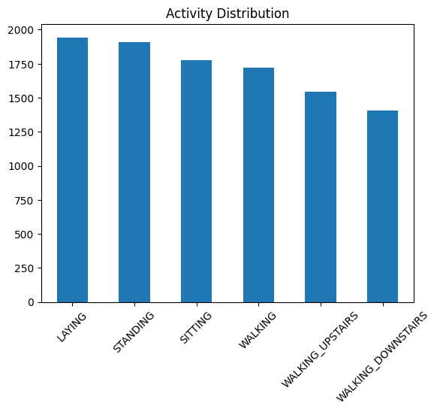
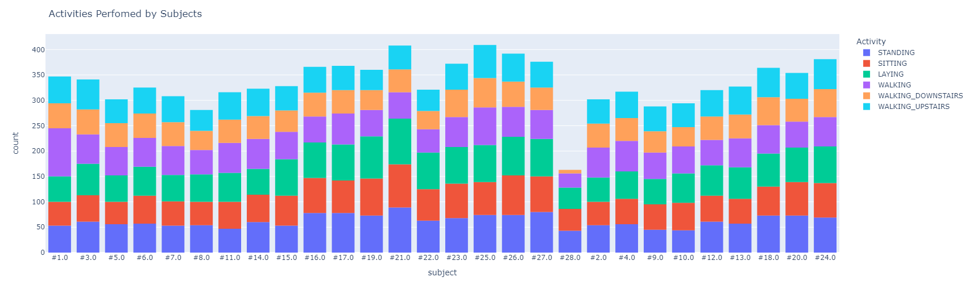
DatA Understanding & Exploration
Activity Distribution
There are 6 activities performed by the research participants labeled as target:
Laying Down
Standing
Sitting
Walking
Walking Upstair
Walking Downstair
Activity Distribution by Subject

Slide 6
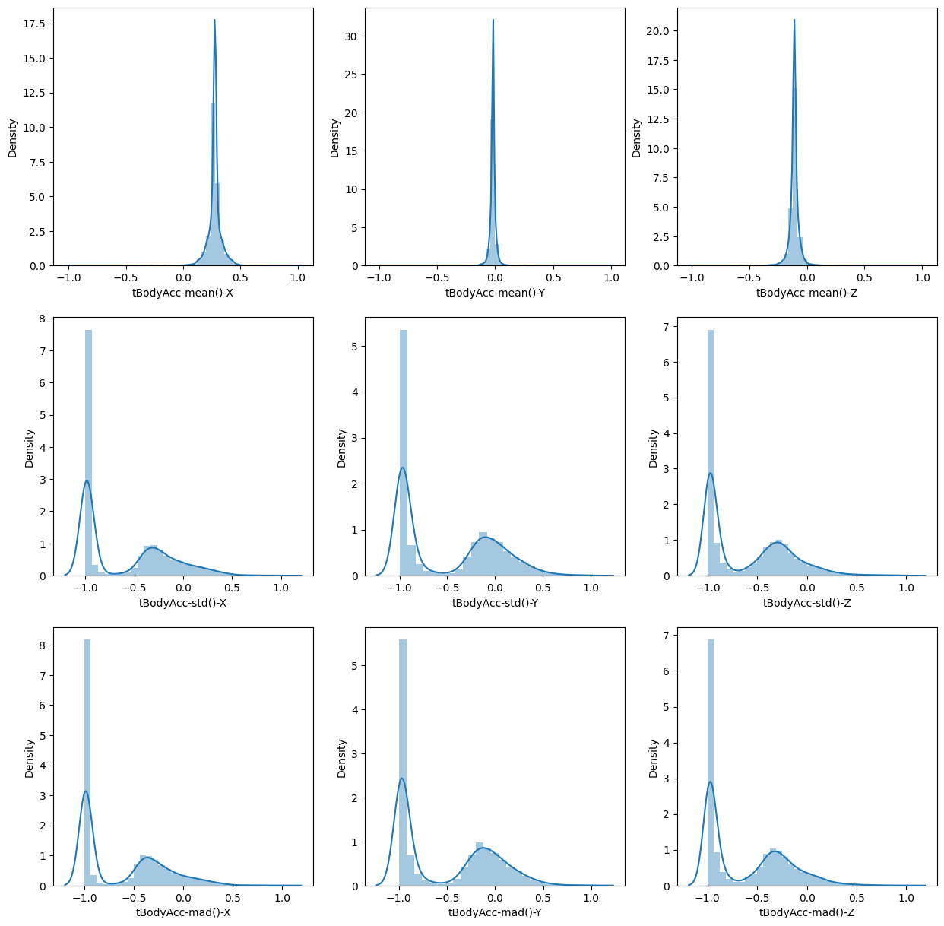
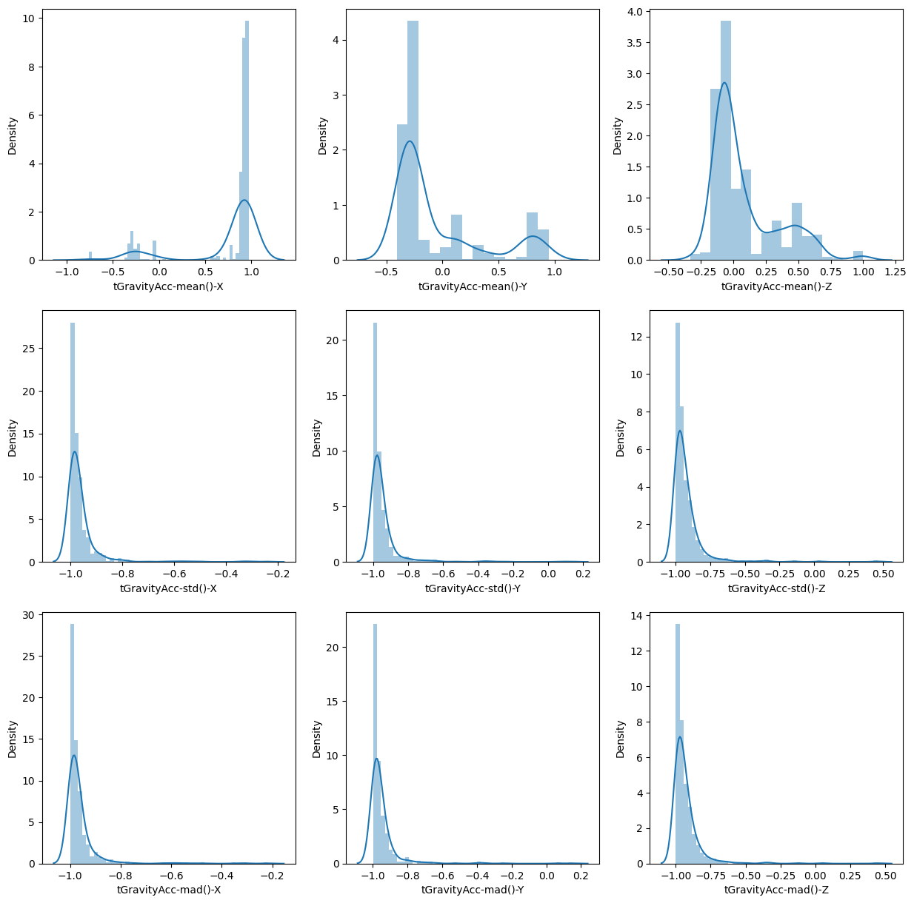
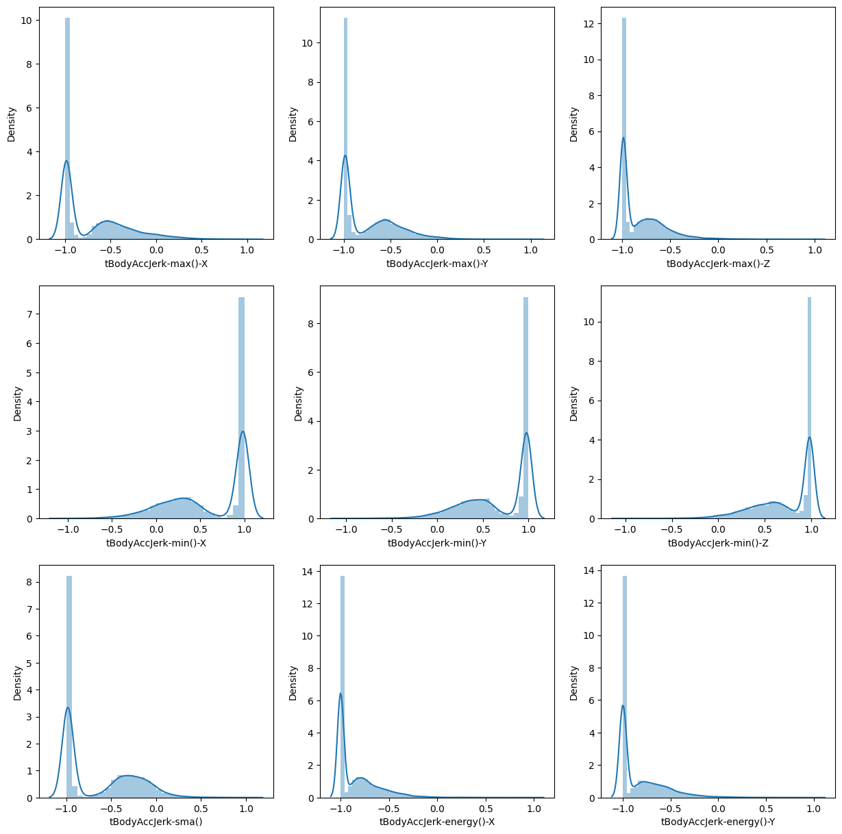
DatA Exploration & Findings
Distribution Plots on Time Domain
tBodyAcc
tGravityAcc
tBodyAccJerk

Slide 7
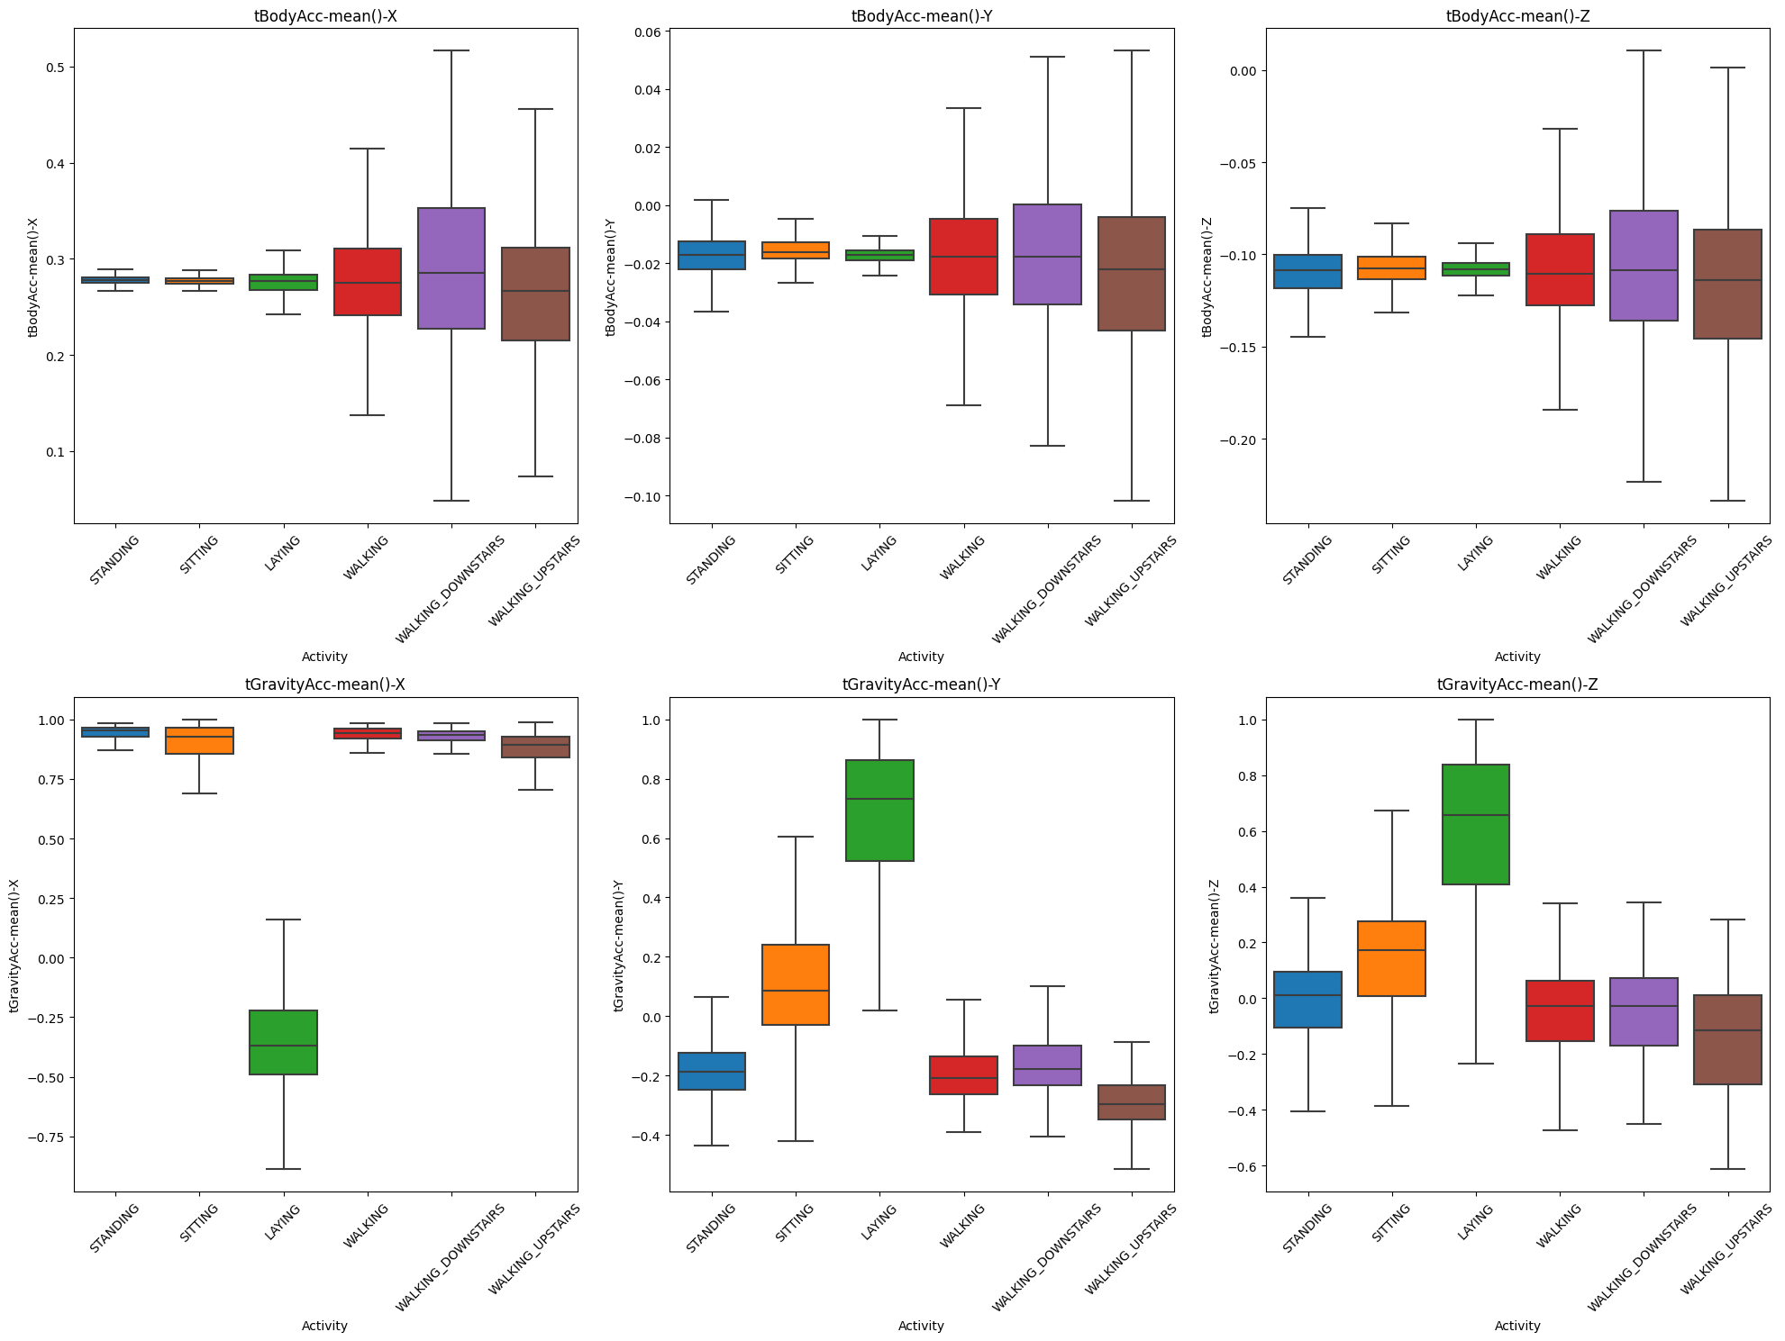
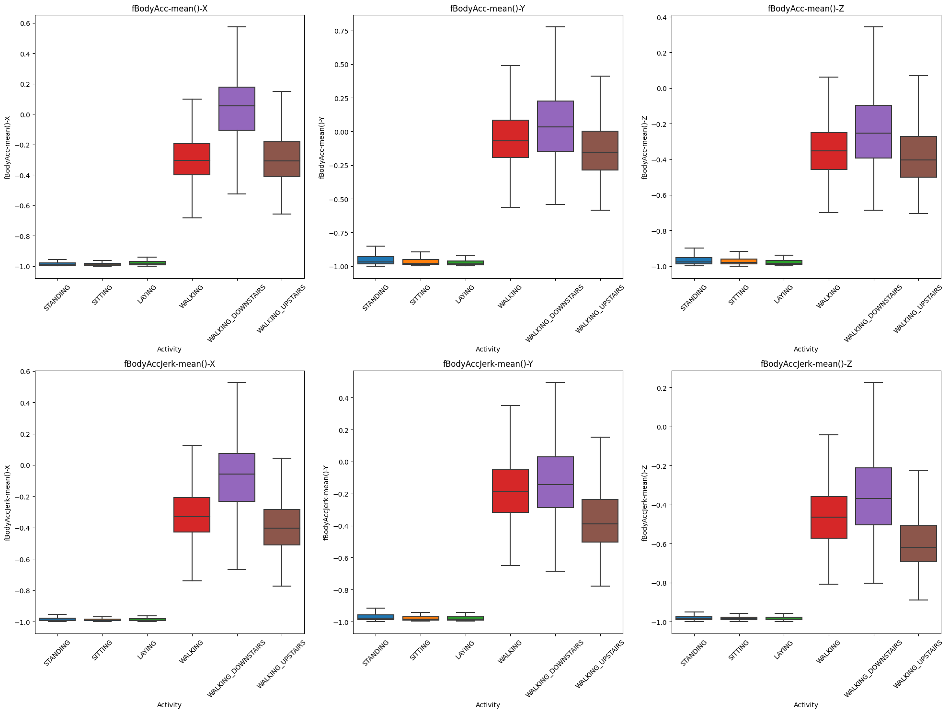
DatA Exploration & Findings
Time Domain vs Frequency Domain
Time Domain
Frequency Domain

Slide 8
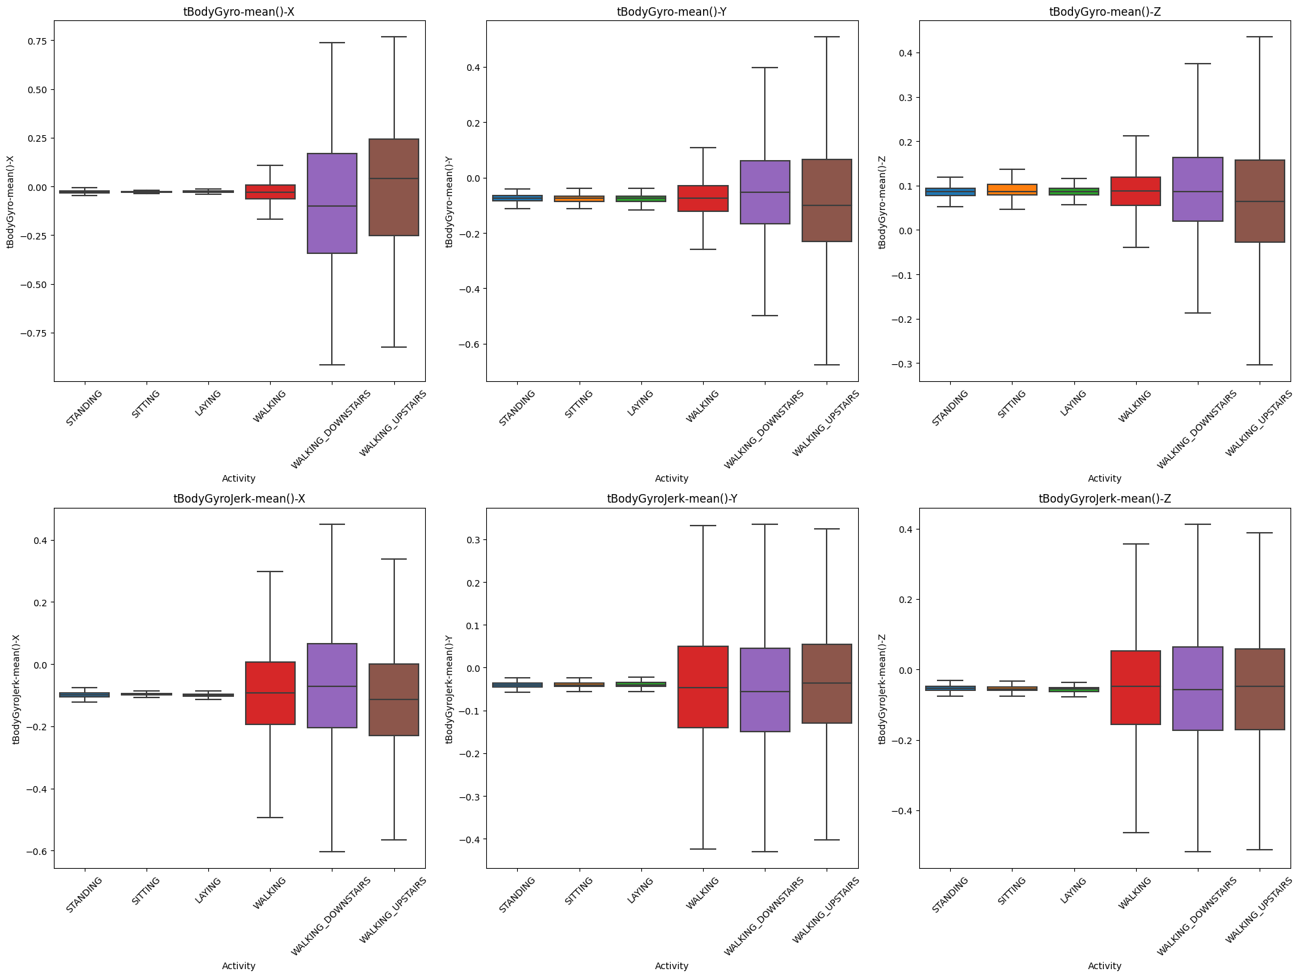
DatA Exploration & Findings
Accelerometer vs Gyroscope
Accelerometer Signals
Gyroscope Signals

Slide 9
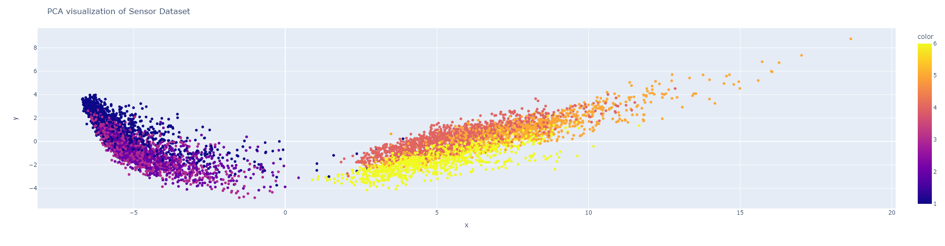
DatA Exploration & Findings
Clustering
PCA = 3
PCA = 2

Slide 10
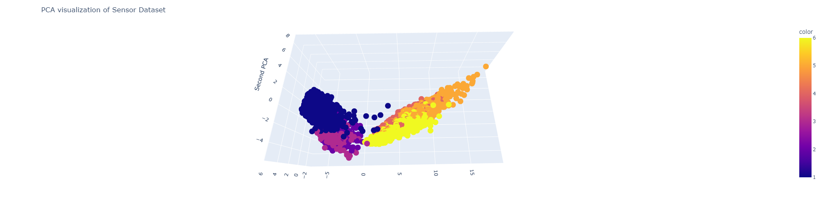
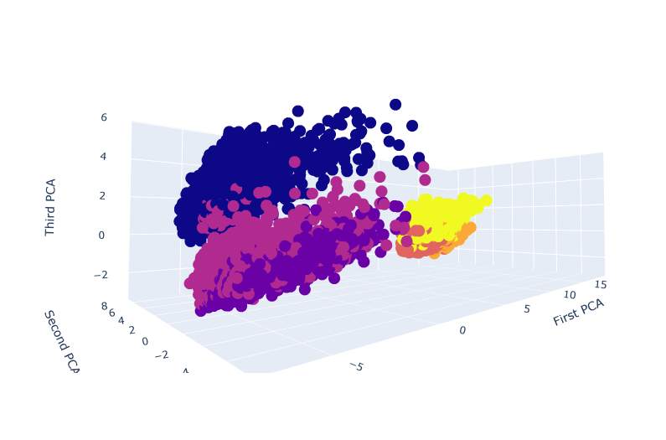
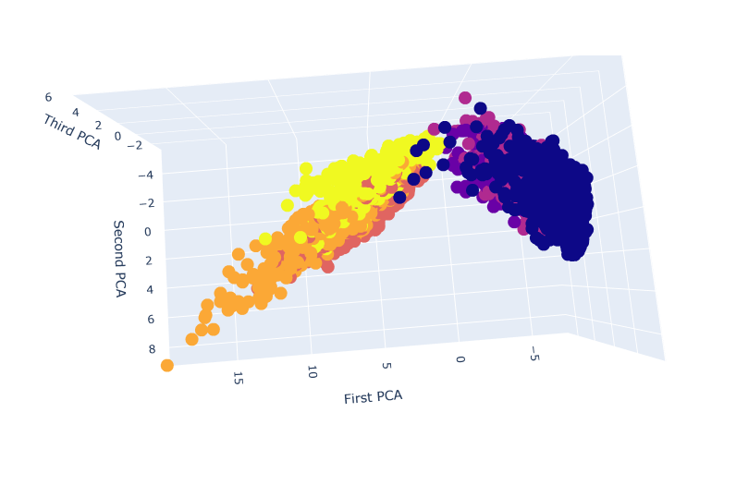
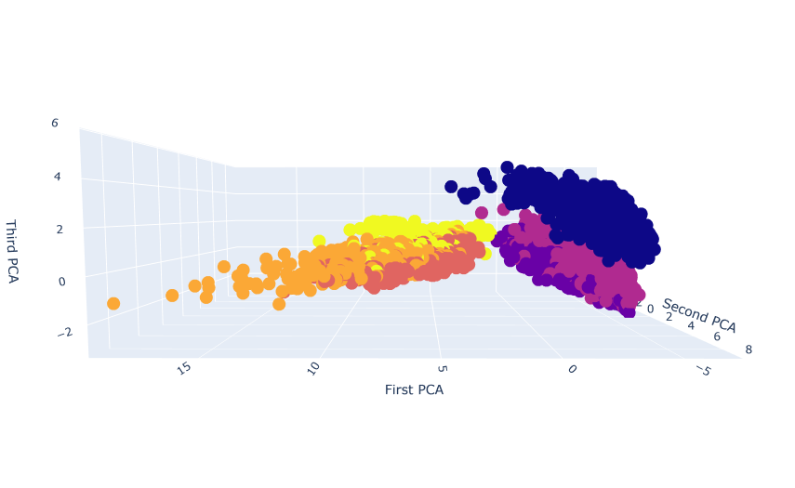
DatA Exploration & Findings
Clustering
PCA = 3

Slide 11
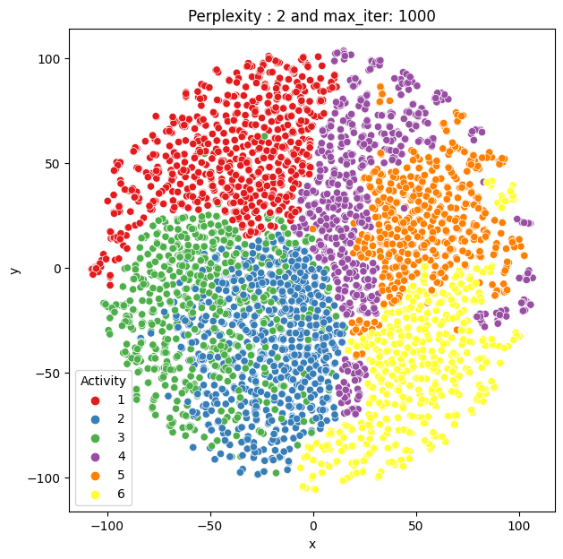
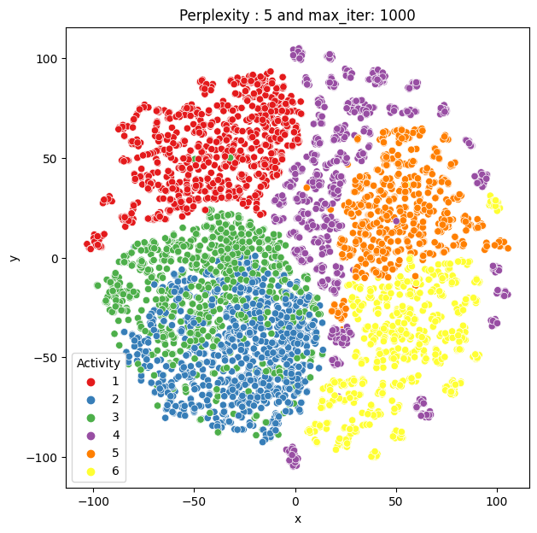
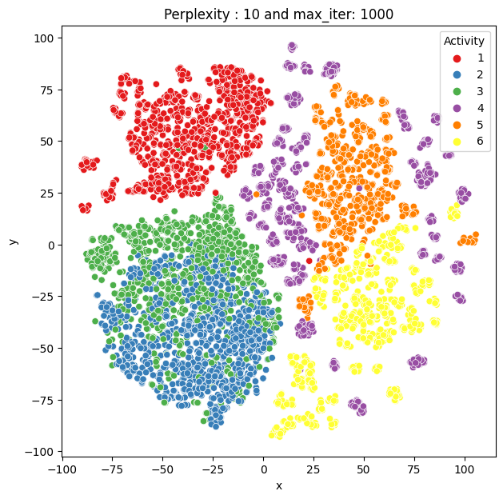
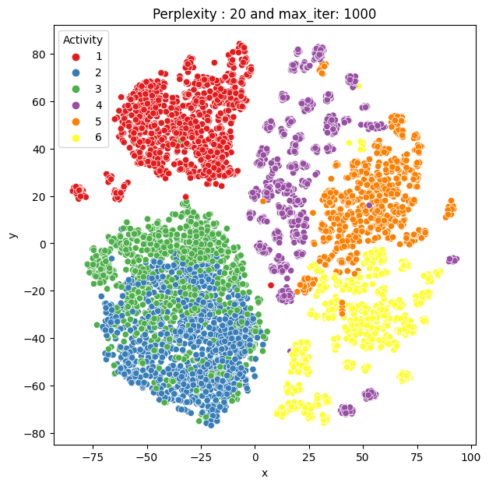
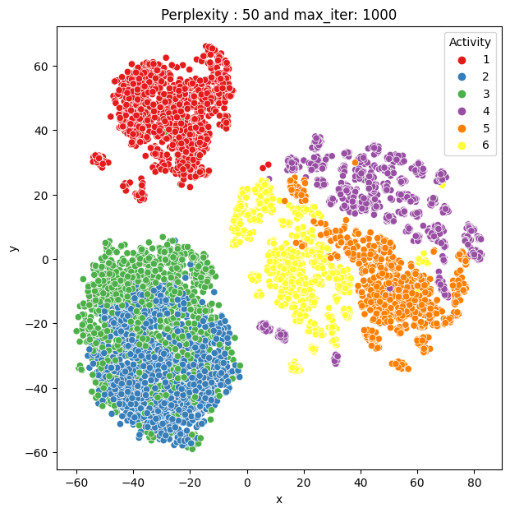
DatA Exploration & Findings
Visualization using t-SNE (T-distributed Stochastic Neighbor Embedding)
Perplexity = 2
Perplexity = 5
Perplexity = 10
Perplexity = 20
Perplexity = 50
T-SNE can help reduce the dimensionality of the dataset. Perplexity is a tuning parameter which balance the attention between local and global aspect of the data. The typical value is between 5 to 50.
Based on the visualization above of perplexity value of 2, 5, 10, 20 and 50 with a fixed iteration of 1000. You can see that some pattern in the cluster. Among the activity, 3 of the activities are stationary (#1, #2, #3) and other 3 are in motion when participant is walking (#4, #5, #6)
Coincidently, ‘stationary’ clusters are grouped together separated from the ‘motion’ clusters. One explanation is that gravitational and angular acceleration component is changing in periodic pattern when the participant is walking.

Slide 12
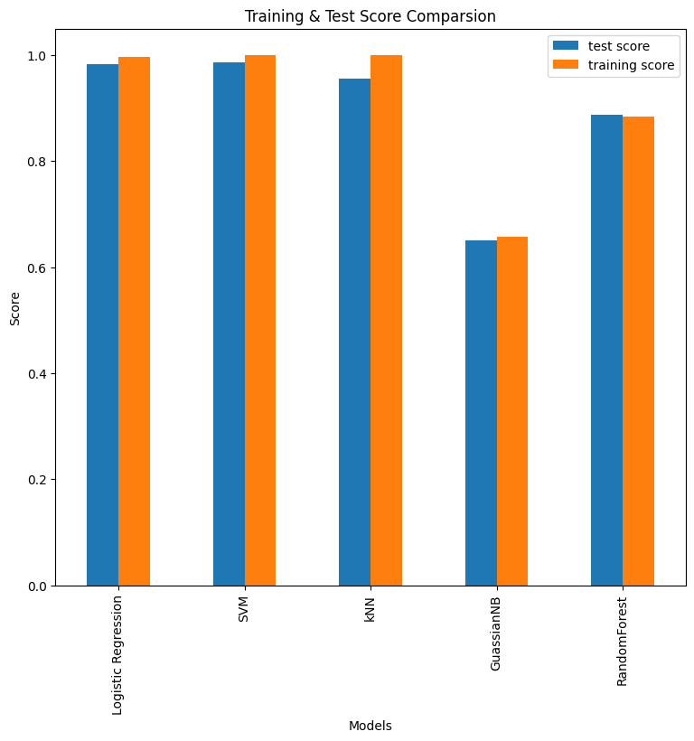
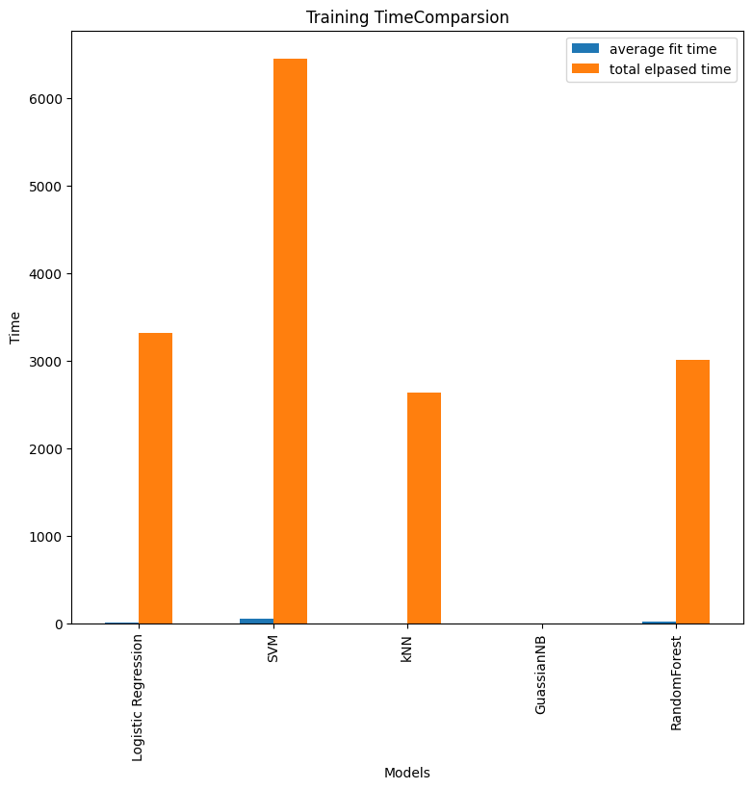
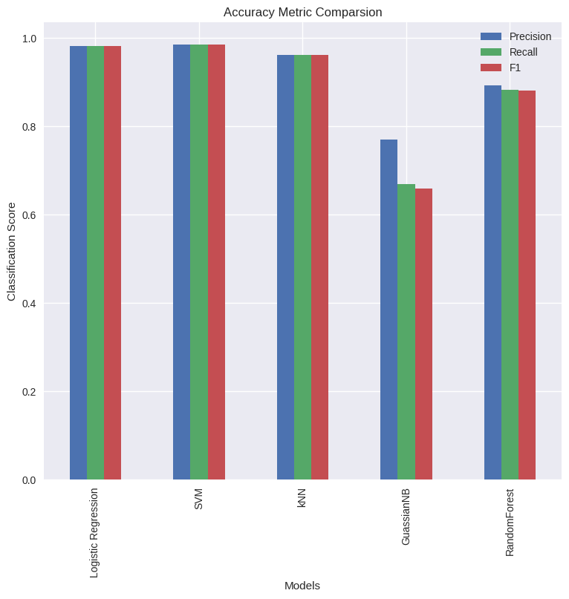
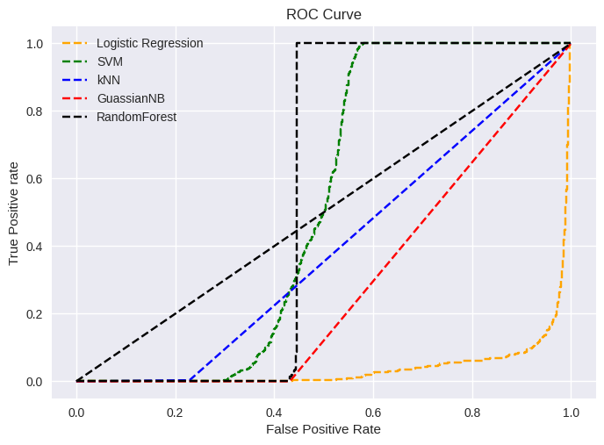
Data Modeling & Evaluation
6 Models are Evaluated to implement the Activity Classifier
Logistic Regression with Multinominal
SVM
kNN
Gaussian Naïve Bayes
Random Forest Classifier
Recurrent Neural Network (RNN)
Based on Test Score generated by gridSearchCV, SVM model has the highest test score with its best parameters. Closely follow by Logistic Regression using multinomial. This is verified using accuracy metric generated through classification report. SVM yield the highest Precision, recall and F1 value. However the downside of SVM is reflected in training time as it takes at least 2x to 3x as long compare to other models.
Regarding ROC Curve, SVM and Random Forest has the highest performance as a classification model. ROC curve plot TPR compare to FPR at different classification threshold. Interesting, Logistics Model has an invested curve. A potential remedy is remove the max iteration.
As for deep learning, a simple RNN is used with Sequential model. It produced a TP value off 3700 (True Positive) with no False Positive and vice versa with Negative scenarios. Also It produces a precision score of 1.0 which also mean no false positive. A recall score of 1.0 mean it has no false negative.
In conclusion, due to the fact that SVM require a lengthy modelling time, it will increase the cost of the model over the lifespan of the deployment. It is recommended to use RNN to develop the human activity classifier for its high precision and accuracy rate.

Slide 13
THANK YOU

